Slide 1
Computer Systems for Data Science Topic 3
Borrowed from Shiva Shivakumar
Transactions

Slide 2
Transactions

Slide 3
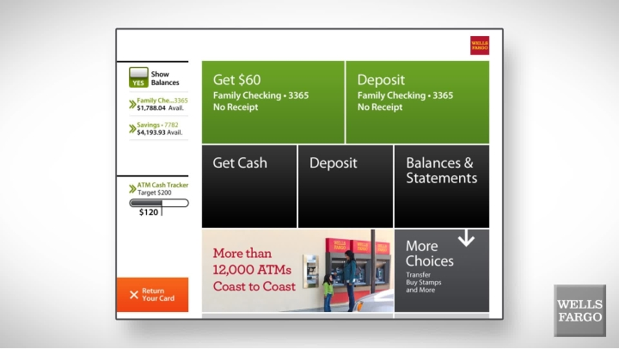
Motivating example: an ATM
Read Balance
Give money
Update Balance
Read Balance
Update Balance
Give money
vs
Notes:
Now let’s unpack another real world system. How do Bank ATMs work?
Reads for retrieving account balance, Update when you deposit/withdraw money
Now let’s walk through a transaction. You withdraw 60$. Let’s pause. Imagine what steps the ATM goes through?
Here’s a 1st cut...Read Balance, Give Money, Update Balance. Does that work?
How can you break this? E.g., pull the power cord after you get money before it updates balance. Now what if we reverse the actions?
Now imagine how would you design a system around this?

Slide 4
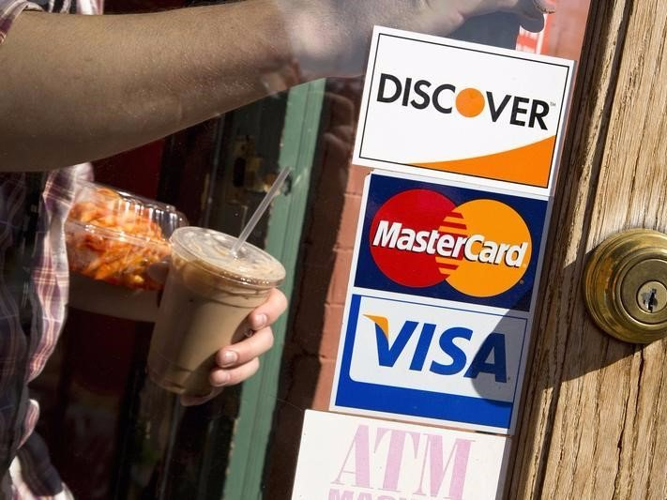


It’s not just about having the correct balance…
Want your 4$ Starbucks transaction to wait for a 10k$ bet in Las Vegas ?
(Transactions can (1) be quick or take a long time, (2) unrelated to you)
Visa does > 60,000 TXNs/sec with users & merchants
Notes:
Now it’s not just about making sure your

Slide 5


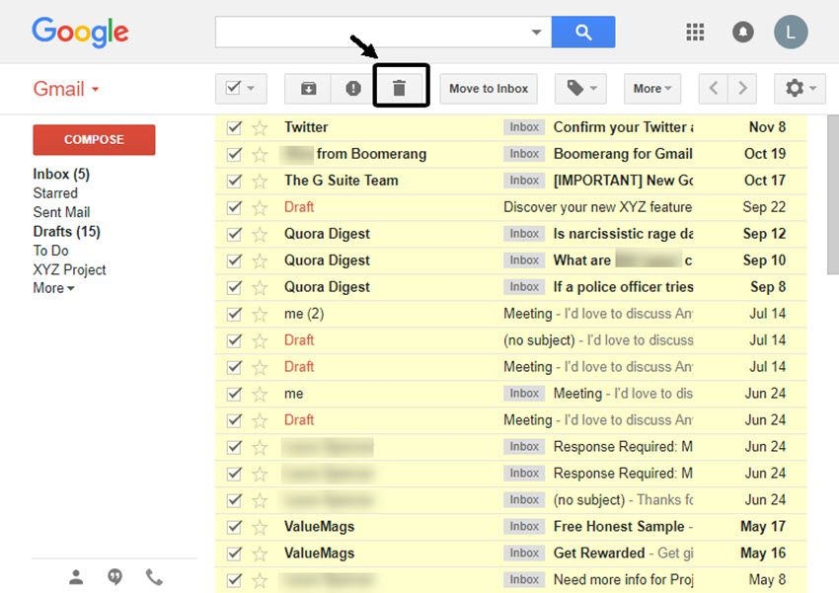
Transactions are not just used for finance
Transactions are at the core of
-- payment, stock market, banks, ticketing
-- Gmail, Google Docs (e.g., multiple people editing)

Slide 6
Transactions

Slide 7
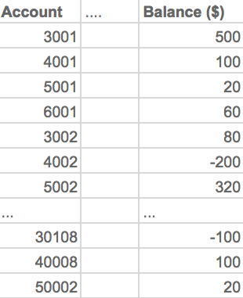
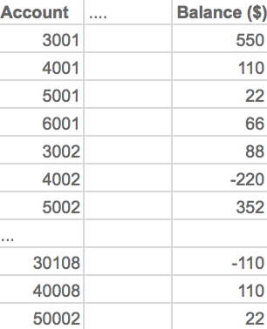
Example: monthly bank interest transaction
Money
Money (@4:29 am day+1)
‘T-Monthly-423’
Monthly Interest 10%
4:28 am Starts run on 10M bank accounts
Takes 24 hours to run
UPDATE Money
SET Balance = Balance * 1.1
Notes:
So let’s say you have a table that stores the balance in a lot of different accounts.
Now let’s say once a month, you need to update the balance on each account, based on the interest rate.
Let’s say the interest rate is 10%.
At 4:28 we start the transaction
Then after 1 day, it is complete. Everything looks great!

Slide 8
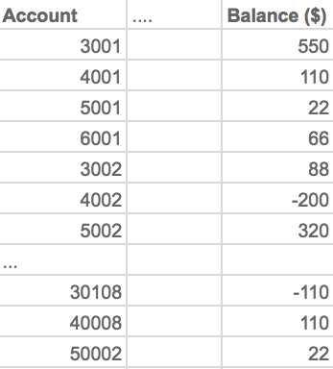
Example: monthly bank interest transaction with crash
Money
Money (@10:45 am)
??
??
??
??
‘T-Monthly-423’
Monthly Interest 10%
4:28 am Starts run on 10M bank accounts
Takes 24 hours to run
Network outage at 10:29 am,
System access at 10:45 am
Notes:
But now imagine we have a crash in the middle of the transaction
Some of the accounts were updated correctly. But some definitely were not!
This is a big problem. Not only is it possible we got some balances incorrectly, but in fact, we don’t know which ones are correct and which ones aren’t.

Slide 9
Transactions: Basic Definition
A transaction (“TXN”) is a sequence of one or more operations (reads or writes) which reflects a single real-world transition.
TXN either happened completely or not at all
START TRANSACTION
UPDATE Product SET Price = Price – 1.99 WHERE pname = ‘Gizmo’
COMMIT
Notes:
Now let’s define a transaction.
This is an example of a transaction in SQL below
The basic idea of a transaction is either it happened or didn’t.

Slide 10
Transactions in SQL
In “ad-hoc” SQL, each statement = one transaction
In a program, multiple statements can be grouped together as a transaction
START TRANSACTION
UPDATE Bank SET amount = amount – 100
WHERE name = ‘Bob’
UPDATE Bank SET amount = amount + 100
WHERE name = ‘Joe’
COMMIT
Notes:
In SQL, transactions can combine multiple different commands, using the START TRANSACTION and COMMIT keywords

Slide 11
Motivation for Transactions
Grouping user actions (reads & writes) into transactions helps with two goals:
1. Recovery and Durability: Keeping the DB data consistent and durable in the face of crashes, aborts, system shutdowns, etc.
2. Concurrency: Achieving better performance by parallelizing TXNs without creating anomalies

Slide 12
Motivation -- Recovery & Durability
1. Recovery and durability of user data is essential for reliable database (and other data science systems)
The database may experience crashes (e.g. power outages, etc.)
Individual TXNs may be aborted (e.g. by the user)
Idea: Make sure that TXNs are either durably stored in full, or not at all; keep log to be able to “roll-back” TXNs

Slide 13
Protection against crashes / aborts
Client 1:
INSERT INTO SmallProduct(name, price)
SELECT pname, price FROM Product
WHERE price <= 0.99
DELETE Product
WHERE price <=0.99
Crash / abort!
What goes wrong?
Notes:
Let’s say we want to take all the low priced products from one table, and move them into another table.

Slide 14
Protection against crashes / aborts
Client 1:
START TRANSACTION
INSERT INTO SmallProduct(name, price)
SELECT pname, price FROM Product
WHERE price <= 0.99
DELETE Product WHERE price <=0.99
COMMIT OR ROLLBACK
Now we’d be fine! We’ll see how / why this lecture

Slide 15
Motivation -- Concurrent execution
2. Concurrent execution of user programs is essential for good database performance.
Disk accesses may be frequent and slow- optimize for throughput (# of TXNs), trade for latency (time for any one TXN)
Users should still be able to execute TXNs as if in isolation and such that consistency is maintained
Idea: Have the database handle running several user TXNs concurrently, in order to keep throughput high

Slide 16
Multiple users: single statements
Client 1: UPDATE Product
SET Price = Price – 1.99 WHERE pname = ‘Gizmo’ Client 2: UPDATE Product
SET Price = Price*0.5 WHERE pname = ‘Gizmo’
Two managers attempt to discount products concurrently- What could go wrong?
Notes:
Now let’s say we have these two operations executed by two different clients.
What could go wrong?

Slide 17
Multiple users: single statements
Client 1: START TRANSACTION
UPDATE Product SET Price = Price – 1.99 WHERE pname = ‘Gizmo’
COMMIT Client 2: START TRANSACTION
UPDATE Product SET Price = Price*0.5 WHERE pname=‘Gizmo’
COMMIT

Slide 18
Lecture 4

Slide 19
Recap of lecture 3
SQL (continued)
Foreign keys (adding a constraint on insertions)
JOINs
Inner
Outer
Aggregations: SUM/COUNT/MIN/MAX/AVG
GROUP BY + aggregates
HAVING
Nested queries
Breaking into steps
Including aggregates, GROUP BY
Transactions motivation:
Key idea: either entire operations is executed, or it is not
Transactions in SQL
Two key challenges
Durability and recovery (surviving crashes, making sure we can rollback)
Concurrent operations (allow transactions to execute in parallel and in isolation)

Slide 20
Today: deep dive on transactions
ACID
Atomicity and durability via logging
Write ahead log
Consistency and isolation via locking
2 Phase Locking
If we have time: conflict serializability

Slide 21
Logistics
Written homework will be released at the end of this week
Meant as preparation for midterm
After this class, you will have the material to solve most (but not all) of it
Reminder: SQL programming homework due next week at noon on Thursday
We covered all the material to solve it

Slide 22
ACID Atomicity, Consistency, Isolation, Durability
Borrowed from Shiva Shivakumar

Slide 23
Transaction Properties: ACID
Atomic
State shows either all the effects of txn, or none of them
Consistent
Txn moves from a state where integrity holds, to another where integrity holds
Isolated
Effect of txns is the same as txns running one after another (ie looks like batch mode)
Durable
Once a txn has committed, its effects remain in the database
ACID continues to be a source of great debate!

Slide 24
ACID: Atomicity
TXN’s activities are atomic: all or nothing
Intuitively: in the real world, a transaction is something that would either occur completely or not at all
Two possible outcomes for a TXN
It commits: all the changes are made
It aborts: no changes are made

Slide 25
ACID: Consistency
The tables must always satisfy user-specified integrity constraints
Examples:
Account number is unique
Stock amount can’t be negative
Sum of debits and of credits is 0
How consistency is achieved:
Programmer writes a TXN to go from one consistent state to a consistent state
System makes sure that the TXN is atomic
→ Assuming system maintaining atomicity, this is often the user’s responsibily

Slide 26
ACID: Isolation
A transaction executes concurrently with other transactions
Isolation: the effect is as if each transaction executes in isolation of the others.
E.g. Should not be able to observe changes from other transactions during the run

Slide 27
ACID: Durability
The effect of a TXN must continue to exist (“persist”) after the TXN
And after the whole program has terminated
And even if there are power failures, crashes, etc.
And etc…
Means: Write data to disk
And in data center settings: replicate data, backup, etc.

Slide 28
Challenges for ACID properties
In spite of power failures (i.e., in spite of loss of memory)
Users may abort the program: need to “rollback changes”
Need to log what happened
Many users executing concurrently
And all this with… Scalability and/or Performance!!
Notes:
Achieving ACID while scaling and providing good performance is a very active area of research still

Slide 29


A Note: ACID is contentious!
Many debates over ACID, both historically and currently
Some “NoSQL” DBs relax ACID
In turn, now “NewSQL” reintroduces ACID compliance to NoSQL-style DBs…

Slide 30
Atomicity and Durability via Logging

Slide 31
Goal for this lecture: Ensuring Atomicity & Durability
ACID
Atomicity:
TXNs should either happen completely or not at all
If abort / crash during TXN, no effects should be seen
TXN 1
Crash / abort
No changes persisted
Durability:
If DB stops running, changes due to completed TXNs should all persist
Just store on stable disk
TXN 2
All changes persisted
We’ll focus on how to accomplish atomicity (via logging)

Slide 32
Basic Idea: (Physical) Logging
Idea:
Log consists of an ordered list of update records
Log record contains UNDO information for every update!
<TransactionID, location, old data, new data>
What DB does?
Owns the log “service” for all applications/transactions.
Transparent to application or transaction
Sequential writes to log, can flush — force writes to disk
This is sufficient to UNDO any transaction!

Slide 33
A picture of logging
T: R(A=0), W(A=1)
[T reads A=0, writes A=1]
[Update Record]
<Tid, &A, 0,1>
T
Main Memory
Operation recorded in update log in main memory!
A=0
Log
A=1
B=5
Data on Disk
Log on Disk
A=0
Notes:
Let’s say we have a database, with two values.
A = 0, B = 5
The database maintains a copy of these values in memory for fast access, and also stores them on disk (let’s say flash).
Now a client writes a transaction, which tries to read the value of A, and then update it (to 1).
So before writing the value, we create an update record, which records the transaction ID, the location of A, the old value and the new value.
After recording the log, we execute the transaction

Slide 34
Why do we need logging for atomicity?
Couldn’t we just write TXN to disk only once whole TXN complete?
Then, if abort / crash and TXN not complete, it has no effect- atomicity!
With unlimited memory and time, this could work…
However, we need to log partial results of TXNs because of:
Memory constraints (enough space for full TXN??)
Time constraints (what if one TXN takes very long?)
We need to write partial results to disk!
…And so we need a log to be able to undo these partial results!
Notes:
One question you may ask: why don’t we just write the transaction to disk only after its complete
That way if there’s a crash – we lose memory and no harm done. We both don’t have affect and we have durability only for completed transactions

Slide 35
Write-ahead Logging (WAL) Commit Protocol
[Update Record]
T: R(A), W(A)
COMMIT record
Commit after we’ve written log to disk but before we’ve written data to disk…
<Tid, &A, 0,1>
T
Main Memory
A=1
Log
B=5
OK, Commit!
<Tid, &A, 0,1>
If we crash now, is T durable?
Data on Disk
Log on Disk
A=0
Notes:
So how do we maintain atomicity and durability for transactions that are in memory
We add another command: commit, which we write to the log on disk, but before we wrote the data to disk
If we crash now is transaction T is durable?

Slide 36
Write-ahead Logging (WAL) Commit Protocol
T: R(A), W(A)
Commit after we’ve written log to disk but before we’ve written data to disk… this is WAL!
T
Main Memory
OK, Commit!
<Tid, &A, 0,1>
If we crash now, is T durable?
Data on Disk
Log on Disk
A=0
A=1
USE THE LOG!
Notes:
Yes it is, if we flush the commit entry to the log on disk. So we need to make sure the transaction is committed only when we’ve written the log data to disk.
Ok so now that the log entry is in disk, the data in disk is still not updated. So how do we make sure the transaction is durable? We can recover it from the log.

Slide 37
Write-Ahead Logging (WAL)
Algorithm: WAL
For each record update, write Update Record into LOG
Follow two Flush rules for LOG
Rule1: Flush Update Record into LOG before corresponding data page goes to storage
Rule2: Before TXN commits,
Flush all Update Records to LOG
Flush COMMIT Record to LOG
→ Durability
→ Atomicity
Transaction is committed once COMMIT record is on stable storage
Flush Update
Record to LOG
Data Flush
Flush COMMIT Record to LOG
TXN
COMMIT
Rule1: For each record update
Rule2: Before TXN commits

Slide 38
Incorrect Commit Protocol #1
Let’s try committing before we’ve written either data or log to disk…
T: R(A), W(A)
A: 0→1
T
Main Memory
A=1
Log
OK, Commit!
B=5
If we crash now, is T durable?
Data on Disk
Log on Disk
Lost T’s update!
A=0

Slide 39
Incorrect Commit Protocol #2
Let’s try committing after we’ve written data but before we’ve written log to disk…
T: R(A), W(A)
A: 0→1
T
Main Memory
A=1
Log
OK, Commit!
B=5
If we crash now, is T durable? Yes! Except…
Data on Disk
Log on Disk
How do we know whether T was committed??
A=1

Slide 40
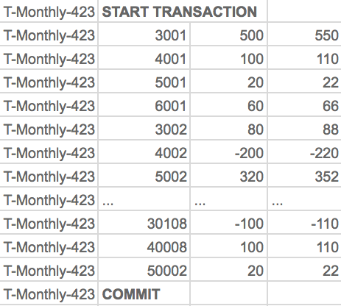
Bank interest example: full run
Money
Money (@4:29 am day+1)
WAL (@4:29 am day+1)
Update
Records
Commit
Record
‘T-Monthly-423’
Monthly Interest 10%
4:28 am Starts run on 10M bank accounts
Takes 24 hours to run
START TRANSACTION
UPDATE Money SET Amt = Amt * 1.10
COMMIT

Slide 41
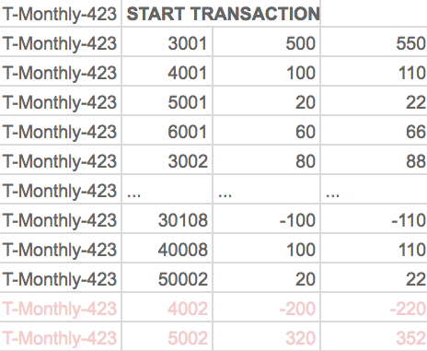
Bank interest example: with crash
Money
Money (@10:45 am)
WAL log (@10:29 am)
??
??
??
??
‘T-Monthly-423’
Monthly Interest 10%
4:28 am Starts run on 10M bank accounts
Takes 24 hours to run
Network outage at 10:29 am,
System access at 10:45 am
Did T-Monthly-423 complete?
Which tuples are bad?
Case1: T-Monthly-423 was crashed
Case2: T-Monthly-423 completed. 4002 deposited 20$ at 10:45 am
Notes:
So now we can check the log and see this transaction was never committed

Slide 42
Bank interest example: with recovery
Money (@10:45 am)
Money (after recovery)
WAL log (@10:29 am)
System recovery (after 10:45 am)
Rollback uncommitted transactions
- Restore old values from WALlog (if any)
- Notify developers about aborted txn
Redo Recent transactions (w/ new values)
Back in business; Redo (any pending) transactions
Notes:
Note that rollback is also a transaction!

Slide 43
A word on performance
Question: why is a WAL a good idea?
Answer: updates to WAL are in sequential order!
Recall: sequential writes are very important both for flash and magnetic disk
In a couple of lectures we will understand why

Slide 44

An example of why sequential writes matter
Money
Money (@4:29 am day+1)
WAL (@4:29 am day+1)
Cost to update all data
10M bank accounts → 10M individual random writes? (worst case)
(@10 ms per write for magnetic disk, that’s 100,000 secs)
Speedup for commit
100,000 secs vs 1 sec when written sequentially!!!
Notes:
Note that rollback is also a transaction!

Slide 45
Concurrency and Locking for Transactions
Borrowed from Shiva Shivakumar

Slide 46
Back to our bank example
Money
Money (@4:29 am day+1)
Other Transactions
10:02 am Acct 3001: Wants 600$
11:45 am Acct 5002: Wire for 1000$
. . . . .
. . . . .
2:02 pm Acct 3001: Debit card for $12.37
‘T-Monthly-423’
Monthly Interest 10%
4:28 am Starts run on 10M bank accounts
Takes 24 hours to run
UPDATE Money
SET Balance = Balance * 1.1
Q: How do I not wait for a day to access my $$$s?

Slide 47

Big idea: locks
Intuition
”Lock” each record for shortest time possible
Key questions
Which records?
For how long?
What is the algorithm for holding them?

Slide 48
Concurrency, Scheduling and Anomalies

Slide 49
Concurrency: Isolation & Consistency
DB is responsible for concurrency so that…
Isolation is maintained: Users must be able to execute each TXN as if they were the only user
Consistency is maintained: TXNs must leave the DB in consistent state
ACID
ACID

Slide 50
Example- consider two TXNs:
T1: START TRANSACTION
UPDATE Accounts SET Amt = Amt + 100
WHERE Name = ‘A’
UPDATE Accounts SET Amt = Amt - 100
WHERE Name = ‘B’
COMMIT
T2: START TRANSACTION
UPDATE Accounts SET Amt = Amt * 1.06
COMMIT
T1 transfers $100 from B’s account to A’s account
T2 credits both accounts with a 6% interest payment
Note:
DB does not care if T1 —> T2 or T2 —> T1 (which TXN executes first)
If developer does, what can they do? (Put T1 and T2 inside 1 TXN)
Notes:
Let’s say we have two transactions. Transaction A transfers 100 dollars from A to B.
Transaction 2 updates all accounts based on the interst.

Slide 51
Example
T₁
A += 100
B -= 100
T1 transfers $100 from B’s account to A’s account
T₂
A *= 1.06
B *= 1.06
T2 credits both accounts with a 6% interest payment
Goal for scheduling transactions:
Interleave transactions to boost performance
Data stays in a good state after commits and/or aborts (ACID)
Notes:
Let’s break down these transactions in how they affect two entries, account A and account B.
Each has two update operations.
Our goal is to interleave these transactions to boost performance, and we want to make sure we maintain isolation and consistency.

Slide 52
Example- consider two TXNs:
We can look at the TXNs in a timeline view- serial execution:
T₁
A += 100
B -= 100
T₂
A *= 1.06
B *= 1.06
Time
T1 transfers $100 from B’s account to A’s account
T2 credits both accounts with a 6% interest payment
Notes:
An easier way to view both transactions is in a timeline serial execution point of view

Slide 53
Example- consider two TXNs:
The TXNs could occur in either order… DB allows!
T₁
A += 100
B -= 100
T₂
A *= 1.06
B *= 1.06
Time
T2 credits both accounts with a 6% interest payment
T1 transfers $100 from B’s account to A’s account
Notes:
The DB is allowed to flip the transactions

Slide 54
Example- consider two TXNs:
The DB can also interleave the TXNs
T₁
A += 100
B -= 100
T₂
A *= 1.06
B *= 1.06
Time
T2 credits A’s account with 6% interest payment, then T1 transfers $100 to A’s account…
T2 credits B’s account with a 6% interest payment, then T1 transfers $100 from B’s account…

Slide 55
Interleaving & Isolation
The DB has freedom to interleave TXNs
However, it must pick an interleaving or schedule such that isolation and consistency are maintained
⇒ Must be as if the TXNs had executed serially!
“With great power comes great responsibility”
ACID
DB must pick a schedule which maintains isolation & consistency

Slide 56
Scheduling examples
Starting Balance
A | B
$50 | $200
Serial schedule T₁,T₂:
T₁
A += 100
B -= 100
T₂
A *= 1.06
B *= 1.06
A | B
$159 | $106
Interleaved schedule A:
Same result!
T₁
A += 100
B -= 100
T₂
A *= 1.06
B *= 1.06
A | B
$159 | $106
Notes:
Let’s look at the following example

Slide 57
Scheduling examples
Starting Balance
A | B
$50 | $200
Serial schedule T₁,T₂:
T₁
A += 100
B -= 100
T₂
A *= 1.06
B *= 1.06
A | B
$159 | $106
Different result than serial T₁,T₂!
Interleaved schedule B:
T₁
A += 100
B -= 100
T₂
A *= 1.06
B *= 1.06
A | B
$159 | $112

Slide 58
Scheduling examples
Starting Balance
A | B
$50 | $200
Serial schedule T₂,T₁:
T₁
A += 100
B -= 100
T₂
A *= 1.06
B *= 1.06
A | B
$153 | $112
Different result than serial T₂,T₁ ALSO!
Interleaved schedule B:
T₁
A += 100
B -= 100
T₂
A *= 1.06
B *= 1.06
A | B
$159 | $112
Notes:
Now you may have already observed that if we flip the serial order of T1 and T2, we will get a different result.
As I said earlier, ACID does not say which order transactions need to occur – so the flipping is allowed. But we have to maintain isolation.
So the interleaved schedule B violates T2,T1 as well, so it does not maintain isolation.

Slide 59
Scheduling examples
Interleaved schedule B:
T₁
A += 100
B -= 100
T₂
A *= 1.06
B *= 1.06
This schedule is different than any serial order! We say that it is not serializable

Slide 60
Scheduling Definitions
A serial schedule is one that does not interleave the actions of different transactions
A and B are equivalent schedules if, for any database state, the effect on DB of executing A is identical to the effect of executing B
A serializable schedule is a schedule that is equivalent to some serial execution of the transactions.
The word “some” makes this definition powerful & tricky!

Slide 61
Serial Schedules
Interleaved Schedules
S1
S3
S2
S4
S5
S6
Serial Schedules
Serializable Schedules
Equivalent Schedules
Non-serializable (Bad) Schedules
S1, S2
S3, S4 (And S1, S2)
<S1, S3>
<S2, S4>
S5, S6
Notes:
Let’s review all possible schedules for these two transactions.
We can take the original transactions and execute them in both orders.
Then we can interleave them like we did before in schedule 3. We can do the reverse where transaction 2 starts the interleaving.
Then we can also do the bad schedule we showed earlier.

Slide 62
Conflicts and Anomalies

Slide 63
General DB model:
Concurrency as Interleaving TXNs
Each action in the TXNs reads a value and then writes one back
Serial Schedule
T₁
R(A)
W(A)
R(B)
W(B)
T₂
R(A)
W(A)
R(B)
W(B)
For our purposes, having TXNs occur concurrently means interleaving their component actions (R/W)
Interleaved Schedule
T₁
R(A)
W(A)
R(B)
W(B)
T₂
R(A)
W(A)
R(B)
W(B)
We call the particular order of interleaving a schedule

Slide 64
Conflict Types
Two actions conflict if they are part of different TXNs, involve the same variable, and at least one of them is a write
Thus, there are three types of conflicts:
Read-Write conflicts (RW)
Write-Read conflicts (WR)
Write-Write conflicts (WW)
Why no “RR Conflict”?
Note: conflicts happen often in many real world transactions. (E.g., two people trying to book an airline ticket)
Notes:
Why no RR conflict?
Because read does not change state. Only write changes the state.
Other examples of conflicts?

Slide 65
Classic Anomalies with Interleaved Execution
“Unrepeatable read”:
T₁
R(A)
R(A)
T₂
R(A)
W(A)
C
“Dirty read” / Reading uncommitted data:
T₁
W(A)
A
T₂
R(A)
W(A)
C
“Inconsistent read” / Reading partial commits:
T₁
W(A)
W(B)
C
T₂
R(A)
R(B)
W(D)
C
Partially-lost update:
T₁
W(A)
W(B)
C
T₂
W(A)
W(B)
C
Notes:
IMS apparently used in the moonshot (http://www-01.ibm.com/software/data/ims/benchmark.html) and still boasts high #s

Slide 66
Conflicts
Two actions conflict if they are part of different TXNs, involve the same variable, and at least one of them is a write
T₁
R(A)
W(A)
R(B)
W(B)
T₂
R(A)
W(A)
R(B)
W(B)
All “conflicts”!
Notes:
So as we said, a conflict is if two actions are part of different TXNs, and they involve the same variable, and at least one of them is a write.
Let’s draw a line between two actions that are a conflict.
So R(A) conflicts with W(A). Does it conflict with R(A)? Or W(B)?

Slide 67
Note: Conflicts vs. Anomalies
Conflicts are in both “good” and “bad” schedules
(they are a property of transactions)
Goal: Avoid Anomalies while interleaving transactions with conflicts!
Do not create “bad” schedules where isolation and/or consistency is broken (i.e., Anomalies)

Slide 68
Conflict Serializability

Slide 69

Conflict Serializability
Two schedules are conflict equivalent if:
They involve the same actions of the same TXNs
Every pair of conflicting actions of two TXNs are ordered in the same way
Schedule S is conflict serializable if S is conflict equivalent to some serial schedule

Slide 70
Example “Good” vs. “bad” schedules
Serial Schedule:
Interleaved Schedules:
T₁
R(A)
W(A)
R(B)
W(B)
T₁
R(A)
W(A)
R(B)
W(B)
T₂
R(A)
W(A)
R(B)
W(B)
T₂
R(A)
W(A)
R(B)
W(B)
Note that in the “bad” schedule, the order of conflicting actions is different than the above (or any) serial schedule!
X
T₁
R(A)
W(A)
R(B)
W(B)
T₂
R(A)
W(A)
R(B)
W(B)
Conflict serializability provides us with an operative notion of “good” vs. “bad” schedules! “Bad” schedules create data Anomalies

Slide 71
The Conflict Graph
Let’s now consider looking at conflicts at the TXN level
Consider a graph where the nodes are TXNs, and there is an edge from T_{i} →T_{j} if any actions in T_{i} precede and conflict with any actions in T_{j}
T₁
R(A)
W(A)
R(B)
W(B)
T₂
R(A)
W(A)
R(B)
W(B)
T₁
T₂

Slide 72
What can we say about “good” vs. “bad” conflict graphs?
Serial Schedule:
Interleaved Schedules:
T₁
R(A)
W(A)
R(B)
W(B)
T₁
R(A)
W(A)
R(B)
W(B)
T₂
R(A)
W(A)
R(B)
W(B)
T₂
R(A)
W(A)
R(B)
W(B)
X
T₁
R(A)
W(A)
R(B)
W(B)
T₂
R(A)
W(A)
R(B)
W(B)

Slide 73
What can we say about “good” vs. “bad” conflict graphs?
Serial Schedule:
Interleaved Schedules:
T₁
T₂
T₁
T₂
X
Simple!
T₁
T₂
Theorem: Schedule is conflict serializable if and only if its conflict graph is acyclic

Slide 74
DAGs & Topological Orderings
A topological ordering of a directed graph is a linear ordering of its vertices that respects all the directed edges
A directed acyclic graph (DAG) always has one or more topological orderings
(And there exists a topological ordering if and only if there are no directed cycles)

Slide 75
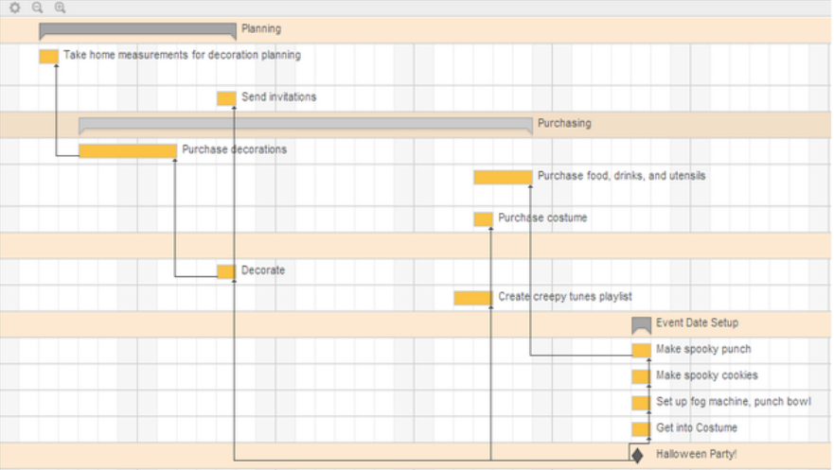
Example: Project dependencies
How would you plan?
What if there are cycles? (dependencies)

Slide 76
DAGs & Topological Orderings
Ex: What is one possible topological ordering here?
0
1
Ex: 0, 1, 2, 3 (or: 0, 1, 3, 2)
2
3
Notes:
What is one topological ordering?

Slide 77
DAGs & Topological Orderings
Ex: What is one possible topological ordering here?
0
1
There is none!
2
3

Slide 78
Connection to conflict serializability
In the conflict graph, a topological ordering of nodes corresponds to a serial ordering of TXNs
Thus an acyclic conflict graph → conflict serializable!
Theorem: Schedule is conflict serializable if and only if its conflict graph is acyclic

Slide 79
Example with 5 transactions
Schedule S1
Good or Bad schedule?
Conflict serializable?
w1(A) | r2(A) | w1(B) | w3(C) | r2(C) | r4(B) | w2(D) | w4(E) | r5(D) | w5(E)
Step1
Find conflicts
(RW, WW, WR)
T1 | w1(A) |  | w1(B)
T2 |  | r2(A) |  |  | R2(C) |  | w2(D)
T3 |  |  |  | w3(C)
T4 |  |  |  |  |  | r4(B) |  | w4(E)
T5 |  |  |  |  |  |  |  |  | r5(D) | w5(E)
‘A’
T2
T4
Step2
Build Conflict graph
Acyclic?
‘B’
‘E’
T1
‘D’
T5
Acyclic
⇒ Conflict serializable!
⇒ Serializable
‘C’
T3
S2
Step3
Example serial schedule
Conflict Equiv to S1
T3 | T1 | T1 | T4 | T4 | T2 | T2 | T2 | T5 | T5
w3(C) | w1(A) | w1(B) | r4(B) | w4(E) | r2(A) | r2(C) | w2(D) | r5(D) | w5(E)
Notes:
Let’s look at a more complicated example.
Let’s say we have 5 transactions.
Each transaction is numbered. For example, transaction 1 consists of w1(a), w1(b), transaction 2 consists of r2(a), r2(c), w2(d)
Now let’s find conflicts… Draw them as a graph

Slide 80
Summary
Concurrency achieved by interleaving TXNs such that isolation & consistency are maintained
We formalized a notion of serializability that captured such a “good” interleaving schedule
We defined conflict serializability

Slide 81
2PL: A Simple Locking Algorithm

Slide 82
Strict Two-Phase Locking (2PL)
Algorithm: strict two-phase locking - as a way to deal with concurrency
Guarantees conflict serializability
(if it completes- see upcoming…)
Also (conceptually) straightforward to implement, and transparent to the user!

Slide 83
Strict Two-phase Locking (2PL) Protocol
TXNs obtain:
An X (exclusive) lock on object before writing.
If a TXN holds, no other TXN can get a lock (S or X) on that object.
An S (shared) lock on object before reading
If a TXN holds, no other TXN can get an X lock on that object
All locks held by a TXN are released when TXN completes.
Note: Terminology here- “exclusive”, “shared”- meant to be intuitive- no tricks!

Slide 84
Picture of 2-Phase Locking (2PL)
# Locks for TXN
Lock Acquisition
Lock Release
On TXN commit!
0 locks
Strict 2PL
Time
2PL: A transaction can not request additional locks once it releases any locks. Thus, there is a “growing phase” followed by a “shrinking phase”.
Strict 2PL: Release locks only at COMMIT (COMMIT Record flushed) or ABORT

Slide 85
Strict 2PL
If a schedule follows strict 2PL, it is conflict serializable…
…and thus serializable
…and we get isolation & consistency!
Popular implementation
Simple !
Produces subset of *all* conflict serializable schedules
There are MANY more complex LOCKING schemes with better performance. (See CS Database classes)
One key, subtle problem (next)

Slide 86
Deadlock Detection
T₁
S(A)
R(A)
T₂
First, T₁ requests a shared lock on A to read from it

Slide 87
Deadlock Detection
T₁
S(A)
R(A)
T₂
S(B)
R(B)
Next, T₂ requests a shared lock on B to read from it

Slide 88
Deadlock Detection: Example
Waits-for graph:
T₁
S(A)
R(A)
T₁
T₂
T₂
Waiting…
S(B)
R(B)
X(A)
W(A)
T₂ then requests an exclusive lock on A to write to it- now T₂ is waiting on T₁…
Waits-For graph: Track which Transactions are waiting
IMPORTANT: WAITS-FOR graph different than CONFLICT graph we learnt earlier !

Slide 89
Deadlock Detection: Example
Waits-for graph:
T₁
S(A)
R(A)
X(B)
Waiting…
T₁
T₂
W(B)
T₂
Waiting…
S(B)
R(B)``
X(A)
W(A)
Cycle = DEADLOCK
Finally, T₁ requests an exclusive lock on B to write to it- now T₁ is waiting on T₂… DEADLOCK!

Slide 90
Deadlocks
Deadlock: Cycle of transactions waiting for locks to be released by each other.
Two ways of dealing with deadlocks:
Deadlock prevention
Deadlock detection

Slide 91
Deadlock Prevention
Conservative 2 Phase Locking (C2PL)
Obtains all locks before the transaction begins
If cannot obtain ALL locks, release and try again
Ensures that no deadlocks occurs
BUT: can degrade performance

Slide 92
Deadlock Detection
Create the waits-for graph:
Nodes are transactions
There is an edge from T_{i} → T_{j} if T_{i} is waiting for T_{j} to release a lock
Periodically check for (and break) cycles in the waits-for graph

Slide 93
Example with 5 Transactions (2PL)
Schedule S1
w1(A) | r2(A) | w1(B) | w3(C) | r2(C) | r4(B) | w2(D) | w4(E) | r5(D) | w5(E)
Execute with 2PL
T1
T2
T3
T4
T5
T2
T4
T1
T5
T3
Waits- For Graph
Waits- For Graph

Slide 94
Example with 5 Transactions (2PL)
Schedule S1
w1(A) | r2(A) | w1(B) | w3(C) | r2(C) | r4(B) | w2(D) | w4(E) | r5(D) | w5(E)
Execute with 2PL
T1
T2
T3
T4
T5
Step 0
X (A)
w1(A)
Step 1
Req S(A)
Step 2
X (B)
w1(B)
Unl B, A
‘A’
(Steps 1, 2)
T2
T4
Step 3
Get S(A)
r2(A)
Step 4
X (C)
w3(C)
Unl C
T1
T5
Step 5
S(C)
r2(C)
T3
Step 6
S(B)
r4(B)
Waits- For Graph
Waits- For Graph
Step 7
X(D)
w2(D)
Unl A, C, D
Step 8
X(E)
w4(E)
Unl B,E
Step 9
S(D)
r5(D)
Step 10
X (E)
w5(E)
Unl D, E

Slide 95
Summary
Locking allows only conflict serializable schedules
If the schedule completes… (it may deadlock!)

